Slide 1
Uva 10537 The Toll! Revisited
Times: 1 second

Slide 2
Problem Descriptions (1/4)
Sindbad the Sailor sold 66 silver spoons to the Sultan of Samarkand. The selling was quite easy; but delivering was complicated. The items were transported over land, passing through several towns and villages.
Each town and village demanded an entry toll.

Slide 3
Problem Descriptions (2/4)
There were no tolls for leaving. The toll for entering a village was simply one item. The toll for entering a town was one piece per 20 items carried.
For example, to enter a town carrying 70 items, you had to pay 4 items as toll.
The towns and villages were situated strategically between rocks, swamps and rivers, so you could not avoid them.

Slide 4
Problem Descriptions (3/4)
Predicting the tolls charged in each village or town is quite simple, but finding the best route (the cheapest route) is a real challenge. The best route depends upon the number of items carried.
For numbers up to 20, villages and towns charge the same. For large numbers of items, it makes sense to avoid towns and travel through more villages, as illustrated in Figure 2.

Slide 5
Problem Descriptions (4/4)
You must write a program to solve Sindbads problem. Given the number of items to be delivered to a certain town or village and a road map, your program must determine the total number of items required at the beginning of the journey that uses a cheapest route.
You will also have to find the cheapest route. If there is more than one such route, print the lexicographically smallest one (A-n-d is smaller than a-n-d).

Slide 6
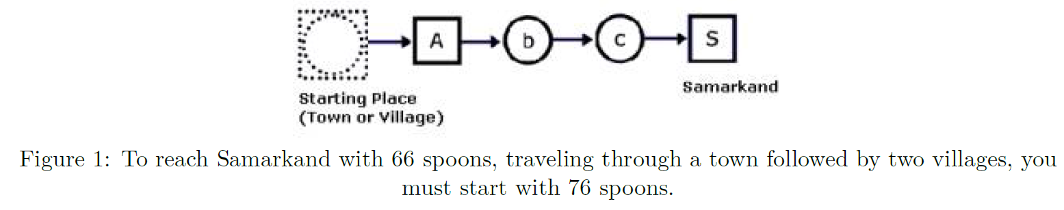
Example 1
76
76
72
71
70

Slide 7
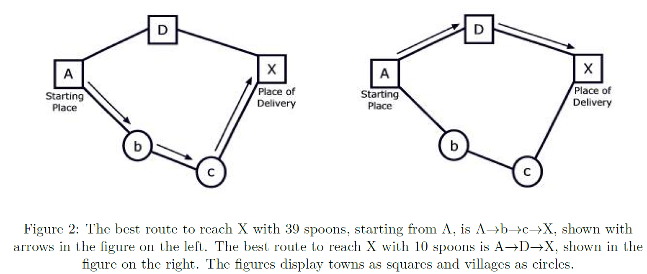
Example 2
42
39
39
45
42
45
42
44
43
42
44
43

Slide 8
Input (1/2)
The input consists of several test cases. Each test case consists of two parts: the roadmap followed by the delivery details.
The first line of the roadmap contains an integer n, which is the number of roads in the map (0≤n).
Each of the next n lines contains exactly two letters representing the two endpoints of a road.
A capital letter represents a town; a lower case letter represents a village.
Roads can be traveled in either direction.

Slide 9
Input (2/2)
Following the roadmap is a single line for the delivery details.
This line consists of three things:
an integer p (0 < p < 1,000,000,000) for the number of items that must be delivered
a letter for the starting place
a letter for the place of delivery.
The roadmap is always such that the items can be delivered. The last test case is followed by a line containing the number ‘-1’.

Slide 10
Output
The output consists of three lines for each test case.
First line displays the case number
second line shows the number of items required at the beginning of the journey
third line shows the path according to the problem statement above.
Actually, the path contains all the city/village names that Sindbad sees along his journey.
Two consecutive city/village names in the path are separated by a hyphen.

Slide 11
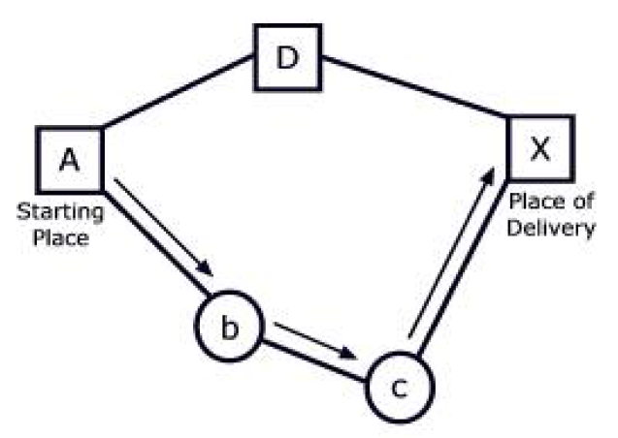

I/O Example
Input
1
a Z
19 a Z
5
A D
D X
A b
b c
c X
39 A X
-1
Output
Case 1:
20
a-Z
Case 2:
44
A-b-c-X
Roadmap
Number of roads
Roads
Delivered items
Start point
End point

Slide 12
Solution
∞
D
42
∞
A
X
start
b
∞
c
∞

Slide 13
Solution
45
D
42
∞
A
X
start
b
44
c
43

Slide 14
Solution
45
D
42
44
A
X
start
b
44
c
43

Slide 15
Solution
45
D
42
44
A
X
start
b
44
c
43

Slide 16
Dijkstra’s Algorithm
Dijkstra(G)
for each v ∈ V
d[v] = ∞;
d[s] = 0; S = ∅; Q = V;
while (Q ≠ ∅)
u = ExtractMin(Q);
S = S U {u};
for each v ∈ u->Adj[]
if (d[v] > d[u]+w(u,v))
d[v] = d[u]+w(u,v);
B∞
10
2
A0
4
3
D∞
5
C∞
1
S = ∅
Q = A, B, C, D

Slide 17
Dijkstra’s Algorithm
Dijkstra(G)
for each v ∈ V
d[v] = ∞;
d[s] = 0; S = ∅; Q = V;
while (Q ≠ ∅)
u = ExtractMin(Q);
S = S U {u};
for each v ∈ u->Adj[]
if (d[v] > d[u]+w(u,v))
d[v] = d[u]+w(u,v);
B∞
u
10
2
A0
4
3
D∞
5
C∞
1
S = A
Q = B, C, D

Slide 18
Dijkstra’s Algorithm
Dijkstra(G)
for each v ∈ V
d[v] = ∞;
d[s] = 0; S = ∅; Q = V;
while (Q ≠ ∅)
u = ExtractMin(Q);
S = S U {u};
for each v ∈ u->Adj[]
if (d[v] > d[u]+w(u,v))
d[v]=d[u]+w(u,v);
v
B10
u
10
2
A0
4
3
D∞
5
C5
1
v
S = A
Q = B, C, D

Slide 19
Dijkstra’s Algorithm
Dijkstra(G)
for each v ∈ V
d[v] = ∞;
d[s] = 0; S = ∅; Q = V;
while (Q ≠ ∅)
u = ExtractMin(Q);
S = S U {u};
for each v ∈ u->Adj[]
if (d[v] > d[u]+w(u,v))
d[v]=d[u]+w(u,v);
v
B10
10
2
A0
4
3
D∞
v
5
C5
1
u
S = A,C
Q = B,D

Slide 20
Dijkstra’s Algorithm
Dijkstra(G)
for each v ∈ V
d[v] = ∞;
d[s] = 0; S = ∅; Q = V;
while (Q ≠ ∅)
u = ExtractMin(Q);
S = S U {u};
for each v ∈ u->Adj[]
if (d[v] > d[u]+w(u,v))
d[v]=d[u]+w(u,v);
v
B9
10
2
A0
4
3
D6
v
5
C5
1
u
S = A,C
Q = B,D

Slide 21
Dijkstra’s Algorithm
Dijkstra(G)
for each v ∈ V
d[v] = ∞;
d[s] = 0; S = ∅; Q = V;
while (Q ≠ ∅)
u = ExtractMin(Q);
S = S U {u};
for each v ∈ u->Adj[]
if (d[v] > d[u]+w(u,v))
d[v]=d[u]+w(u,v);
v
B9
10
2
A0
4
3
D6
u
5
C5
1
S = A,C,D
Q = B

Slide 22
Dijkstra’s Algorithm
Dijkstra(G)
for each v ∈ V
d[v] = ∞;
d[s] = 0; S = ∅; Q = V;
while (Q ≠ ∅)
u = ExtractMin(Q);
S = S U {u};
for each v ∈ u->Adj[]
if (d[v] > d[u]+w(u,v))
d[v]=d[u]+w(u,v);
v
B8
10
2
A0
4
3
D6
u
5
C5
1
S = A,C,D
Q = B

Slide 23
Dijkstra’s Algorithm
Dijkstra(G)
for each v ∈ V
d[v] = ∞;
d[s] = 0; S = ∅; Q = V;
while (Q ≠ ∅)
u = ExtractMin(Q);
S = S U {u};
for each v ∈ u->Adj[]
if (d[v] > d[u]+w(u,v))
d[v]=d[u]+w(u,v);
u
B8
10
2
A0
4
3
D6
5
C5
1
v
S = A,C,D,B
Q = ∅

Slide 24
Dijkstra’s Algorithm
Dijkstra(G)
for each v ∈ V
d[v] = ∞;
d[s] = 0; S = ∅; Q = V;
while (Q ≠ ∅)
u = ExtractMin(Q);
S = S U {u};
for each v ∈ u->Adj[]
if (d[v] > d[u]+w(u,v))
d[v]=d[u]+w(u,v);
u
B8
10
2
A0
4
3
D6
5
C5
1
v
S = A,C,D,B
Q = ∅

Slide 25
Dijkstra’s Algorithm
Dijkstra(G)
for each v ∈ V
d[v] = ∞;
d[s] = 0; S = ∅; Q = V;
while (Q ≠ ∅)
u = ExtractMin(Q);
S = S U {u};
for each v ∈ u->Adj[]
if (d[v] > d[u]+w(u,v))
d[v]=d[u]+w(u,v);
How many times is ExtractMin() called?
How many times is Relax called?
A:O(V lg V + E)

Slide 26
一二三四五六七八九十

Slide 27
蔥抓餅口味冰淇淋好讚

Slide 28
擺癡擬島抵載幹蛇抹阿

